Slide 1
Property, Privacy & Access
“If the ultimate vision of blockchain is a fully decentralized world, where ordinary people can control their data, their money and even their own genes, EDNA and its decentralized community can, with time, be one of its cornerstones.”
-Blockleaders Author Paschal Keogh
Investor Slide Deck • 15 Nov 2018

Slide 2
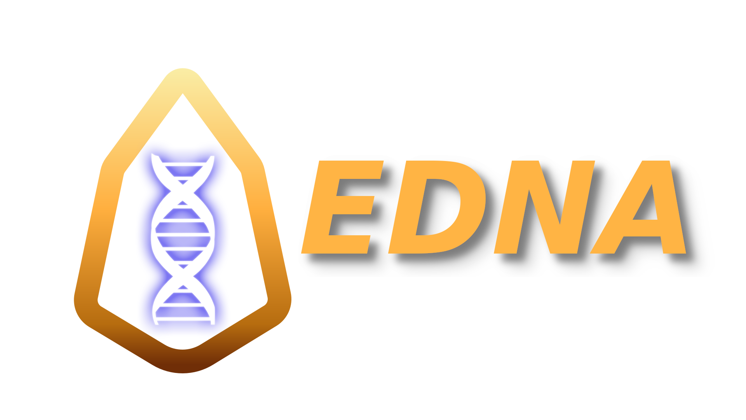
Property, Privacy & Access
Mass Adoption Though Cocktail Parties...
Woman: ”I got my DNA test results and I'm 7% Neanderthal! How much are you?”
Man: ”My EDNA test didn't say, but it did pay me over $50,000 for helping advance genetic research while keeping my identity completely secure.”
Second Woman: (quietly) “Maybe she’s more Neanderthal than she thinks.”

Slide 3
Property, Privacy & Access
KEY PROBLEMS
People today are making a very bad trade: Giving away as much as $70,000.00 to know “how much Neanderthal” they are.
DNA is not “about your identity” – it IS your identity & it’s very unsecured in the current industry.
Lifesaving health information is not easily accessible in the current FDA-Centrally-Controlled system.

Slide 4
Property, Privacy & Access
SOLUTIONS
EDNA allows users to securely store and monetize their own DNA using IPFS and Blockchain Smart Contracts.
Data is obfuscated (like privacy coins) to insure total identity security.
Genetic data is stored in the clear, allowing for value-added processing and full access to user genetics.

Slide 5
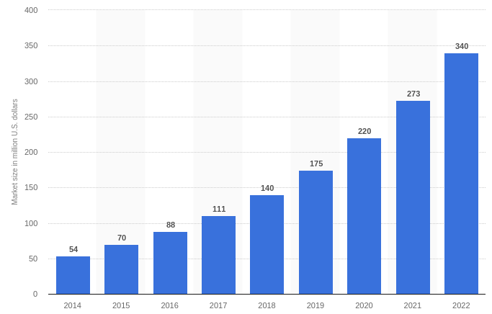
Property, Privacy & Access
CURRENT MARKET
Direct-to-consumer DNA testing

Slide 6
Property, Privacy & Access
PRODUCT TRACTION
Data Volume: SOLVED (EDNA algorithm: 2 Gb → 5 Mb)
Identity Protection: SOLVED (crypto-tumbling)
Monetization: SOLVED
(Zero-KYC opt-in DAC managed blockchain contract)
Transparent Health Information: SOLVED
(can’t arrest the blockchain)
On-boarding: SOLVED (User subsidy free market built into contract)
Scalability: UNSOLVED (Lab can process ½ a person per day – 1,436 people are already waiting in line)

Slide 7
CORE TEAM & KEY CONTRIBUTORS
Property, Privacy & Access
GREG SIMPSON
Founder
LinkedIn
JAMES CALFEE
Special Advisor EOS/block.oneGitHub
JILLIAN GODSIL
VP Media & Press RelationsLinkedIn
MAX GRAVITT
EOS Blockchain Contract Developer Website
JONATHAN SHERIDAN
Industry Business Advisor
LinkedIn
Learn more…
Website

Slide 8
Property, Privacy & Access
THE COMPETITION
Multiple startups in “Monetization of Personal DNA”
None but EDNA publicly address a privacy solution
None but EDNA are organized as a DAC
None but EDNA address full access to genetic variation health information
All but EDNA require hackable centralized trust
None but EDNA are building or built on EOS.IO

Slide 9
Property, Privacy & Access
FINANCIAL BREAKDOWN
Consumables
Overhead
Labor
Equipment
Total Cost to Produce
Value of Electronic DNA in Market
Gross Margin per User
$491.25
$94.83
$10.77
$2.88
$599.72
$70,000.00
$69,443.68
Detailed Breakdown in Appendix #1

Slide 10
Property, Privacy & Access
FUNDING BEING RAISED
Infrastructure + Launch: 5 Million
- Lab Upgrades
- CEO Hire (candidate brings near turn-key readiness)
- Initial 5,000 on chain (fastest path is to pre-own consumables)
On-Going Opportunity: (Unlimited)
DAC Smart Contract includes a marketplace. Invest by subsidizing DNA Owners to get on-chain. Repayment as they monetize. Investor sets return on investment and terms. DNA Owners opt-in. Contract manages funds.
Additional Opportunity:(Equity)
1.3 Billion EDNA Tokens on EOS.IO (300 Million Reserved) Private Sale of some DAC Earnings Still Possible.

